Slide 1


Final Project
Lorenzo Rollhauser
STAT 515

Slide 2
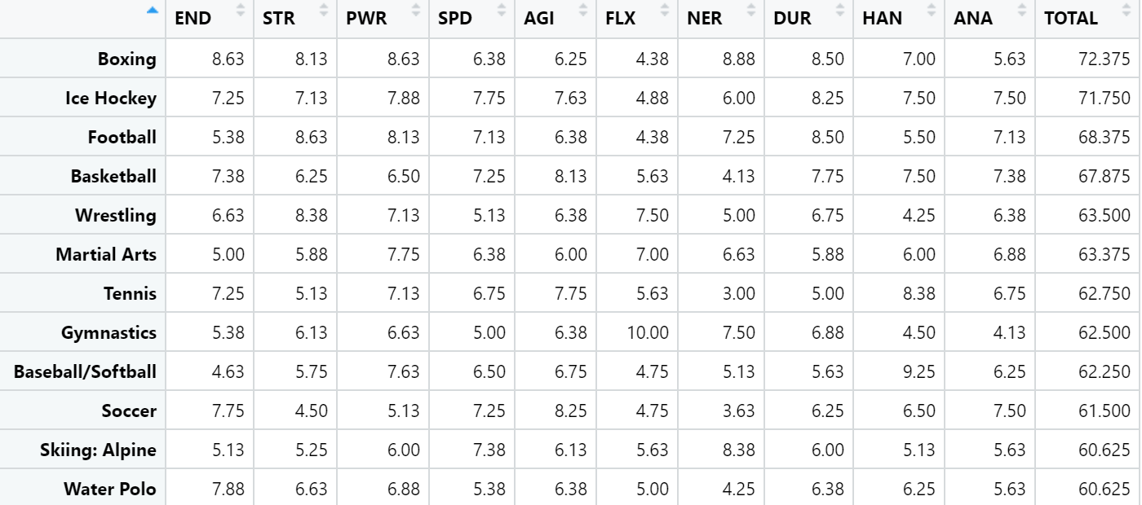
Espn’s Dataset on complexity of sports

Slide 3
Understanding the Dataset
What variables are the most influential in determining difficulty?
Why are some seeming difficult sports ranked low?
How do the variables that determine difficulty relate to each other?

Slide 4
R packages used
ggplot2
cluster
MASS
RColorBrewer
factoextra

Slide 5
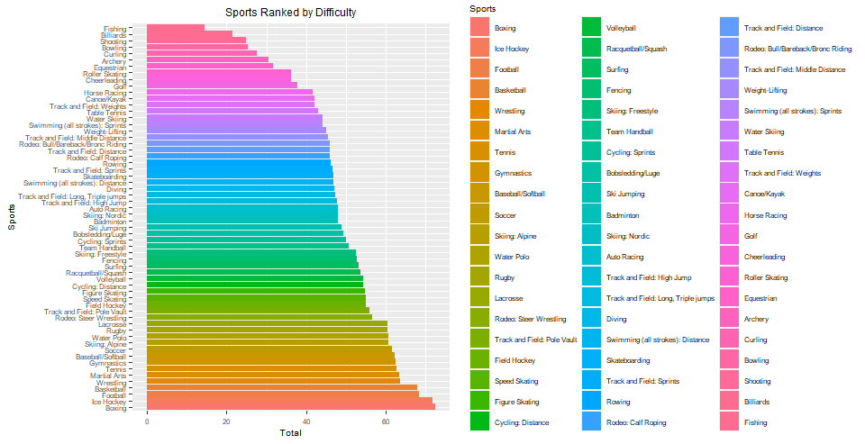
Bar Graph displaying rank by difficulty

Slide 6
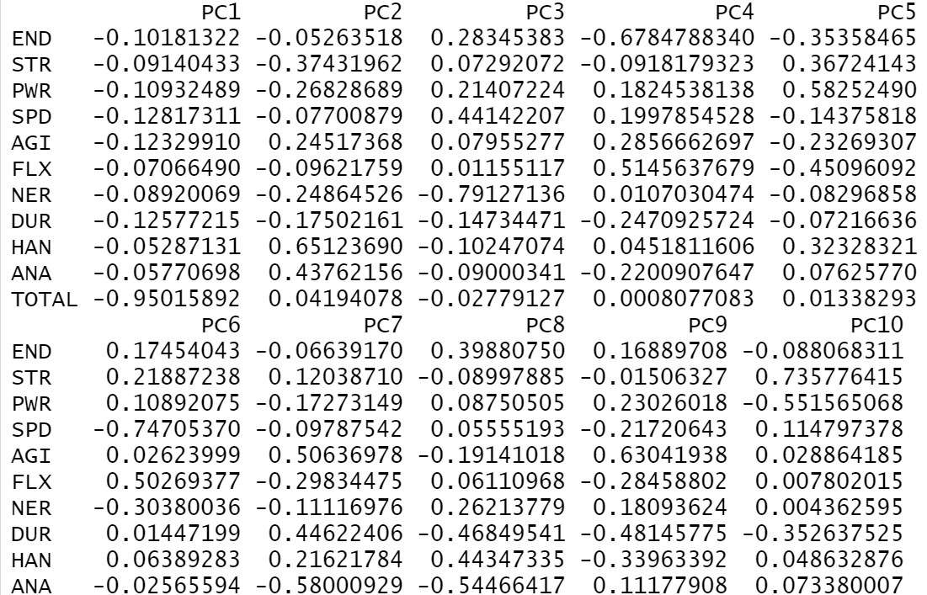
Principal component analysis

Slide 7
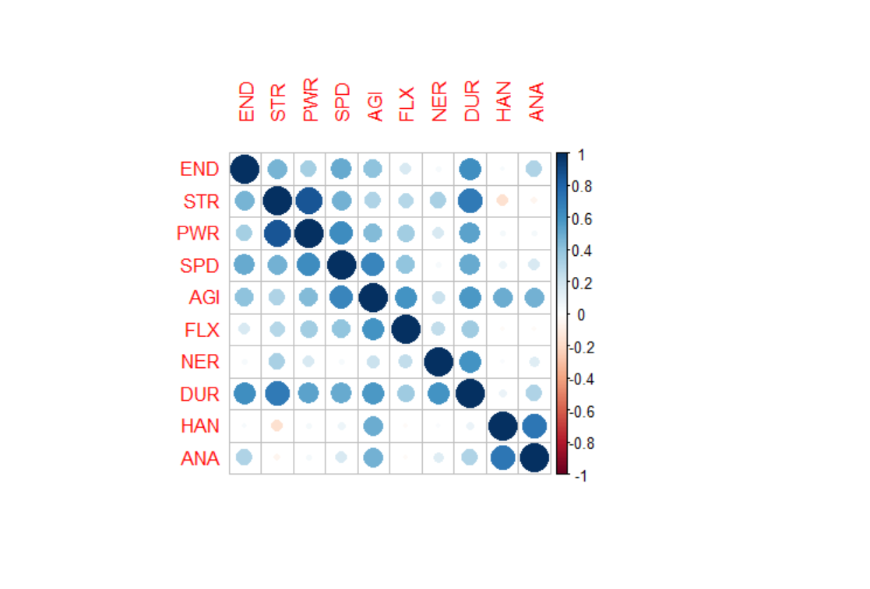
Correlation among variables

Slide 8
K-means Clustering

Slide 9
Distribution of difficulty

Slide 10
Conclusion
The sports that were ranked most difficult had high degree of significance in strength, endurance, power, speed, agility, and durability
Hand-eye coordination, analytical aptitude, and flexibility were not greatly impactful variables in the rankings
Team sports occupy most of the top spots for most difficult sports
Individual sports with limited amounts of movement required occupy the bottom spots in the rankings
Skill should be added as a variable to determine difficulty

Slide 11
References
Hermanson, Corey. “Toughest Sport by Skill - Dataset by Coreyhermanson.” Data.world, 29 Mar. 2017, data.world/coreyhermanson/toughest-sport-by-skill/workspace/data-dictionary.
Zach. “K-Means Clustering in R: Step-by-Step Example.” Statology, 4 Dec. 2020, www.statology.org/k-means-clustering-in-r/.

